Slide 1
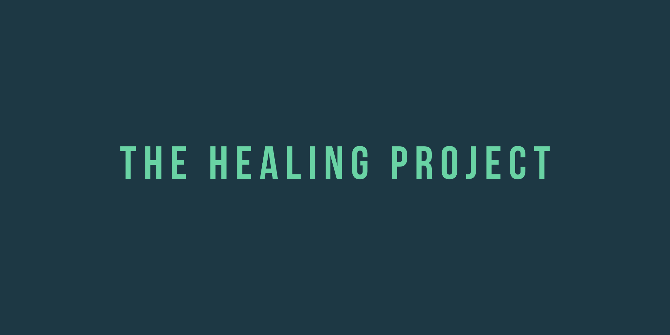

Slide 2
Genesis Story
Earth is suffering. Natural disasters and diseases plague the planet yet humans continue to mine and extract resources at an alarming rate. The biosphere is close to extinction. The animals and humans that survived years of pandemics and chronic disease have inherited a broken health-care system and are stuck with treatments that cause more harm than good.
Most advanced science teams have left the planet in hopes of colonizing new ones, but there is one team of researchers that still believes in saving Earth. They detect life on a planet far beyond our solar system. Considering the urgency to save Earth, the team decides to set off on a goodwill mission called The Healing Project hoping that the inhabitants of the planet are not only hospitable, but also hold the vital wisdom they need.
They make it safely to the lush, healthy planet and discover a lost connection between earthly beings and the mystical Titans they encounter.

Slide 3
Episode 1: Journey
The green hues of the planet were inviting against a backdrop of dark and mysterious moons. Luckily, they didn’t take any wrong turns during their journey. But there were challenges.
Notes:
External Link
Description

Slide 4
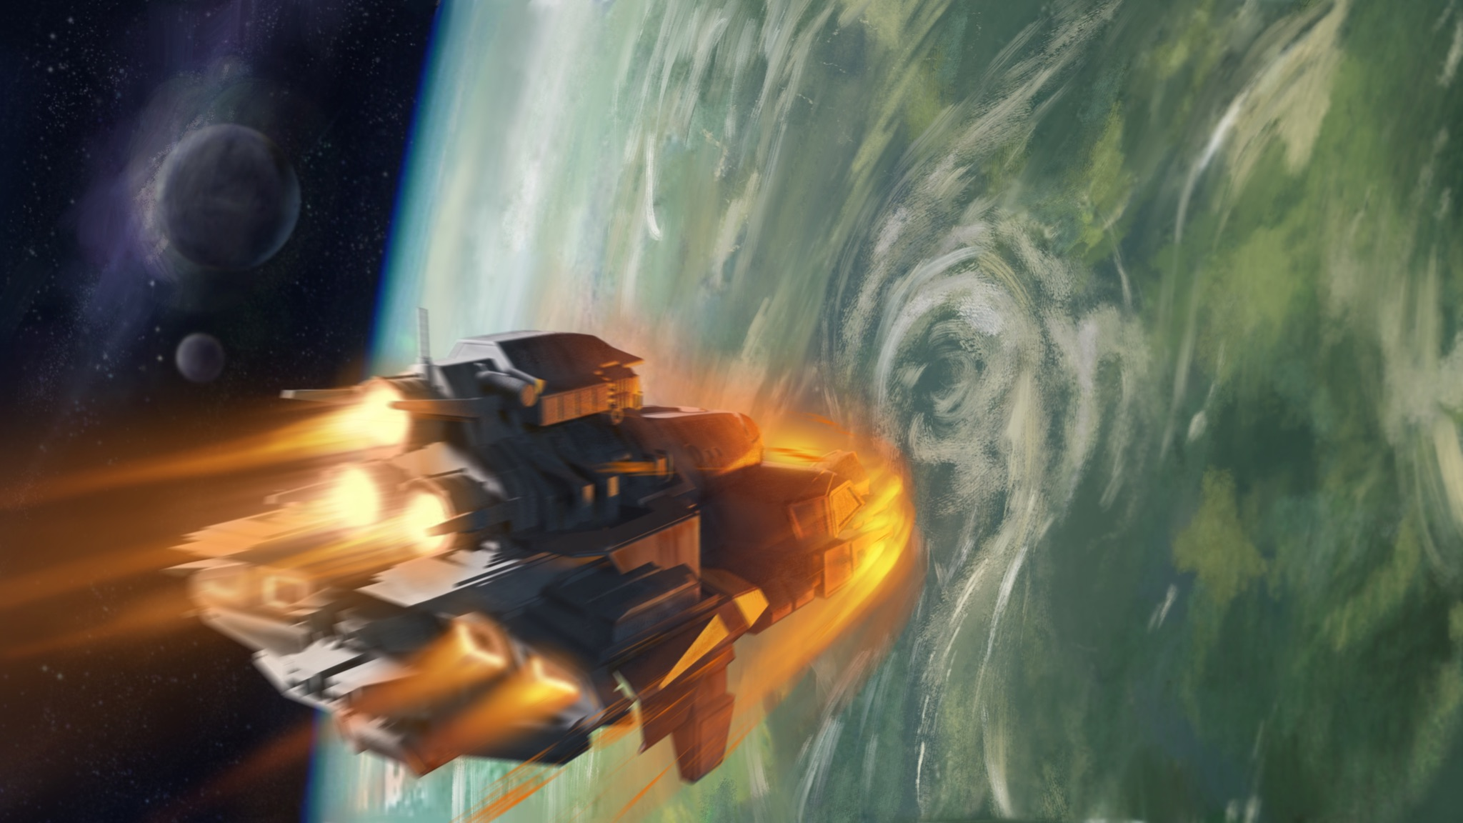

Slide 5
Episode 2: Familiar Feeling
What’s going on here? It looks familiar. Have humans been here before?

Slide 6
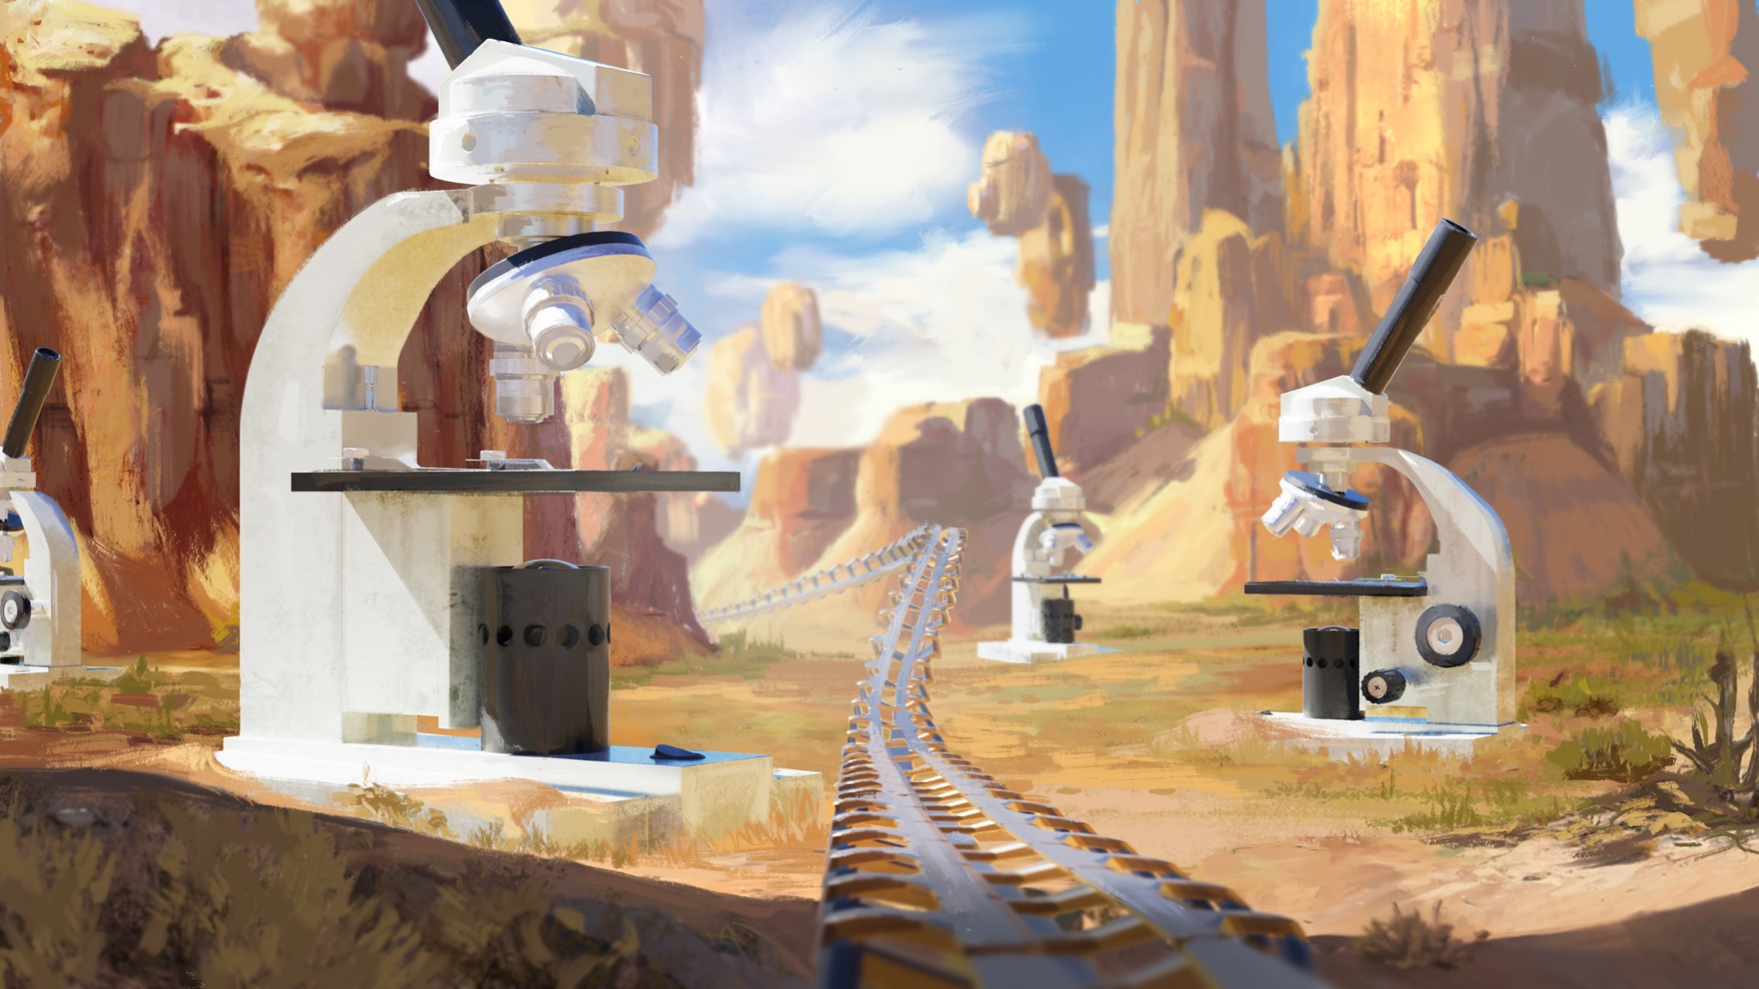
Notes:
Episode 2: The Journey

Slide 7
Episode 3: Inevitable
Misty waterfalls lended a comforting backdrop as a towering being approached. There was no time for fear, no escaping this encounter. Turns out, it would be worth their while.
Notes:
External Link
Description

Slide 8
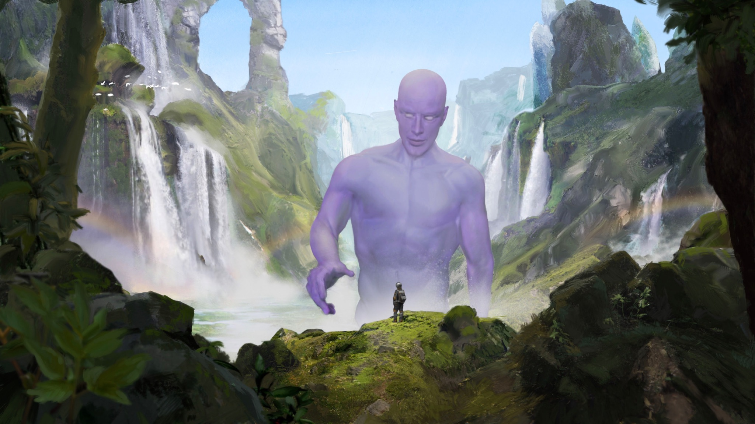
Notes:
Name: First Encounter
We are directed to seek the path through the mountain

Slide 9
Episode 4: Beyond
Empowered with the Titan's wisdom, the explorers set out in search of the Orb of Healing, wherein lies the answers they seek.
Notes:
External Link
Description

Slide 10
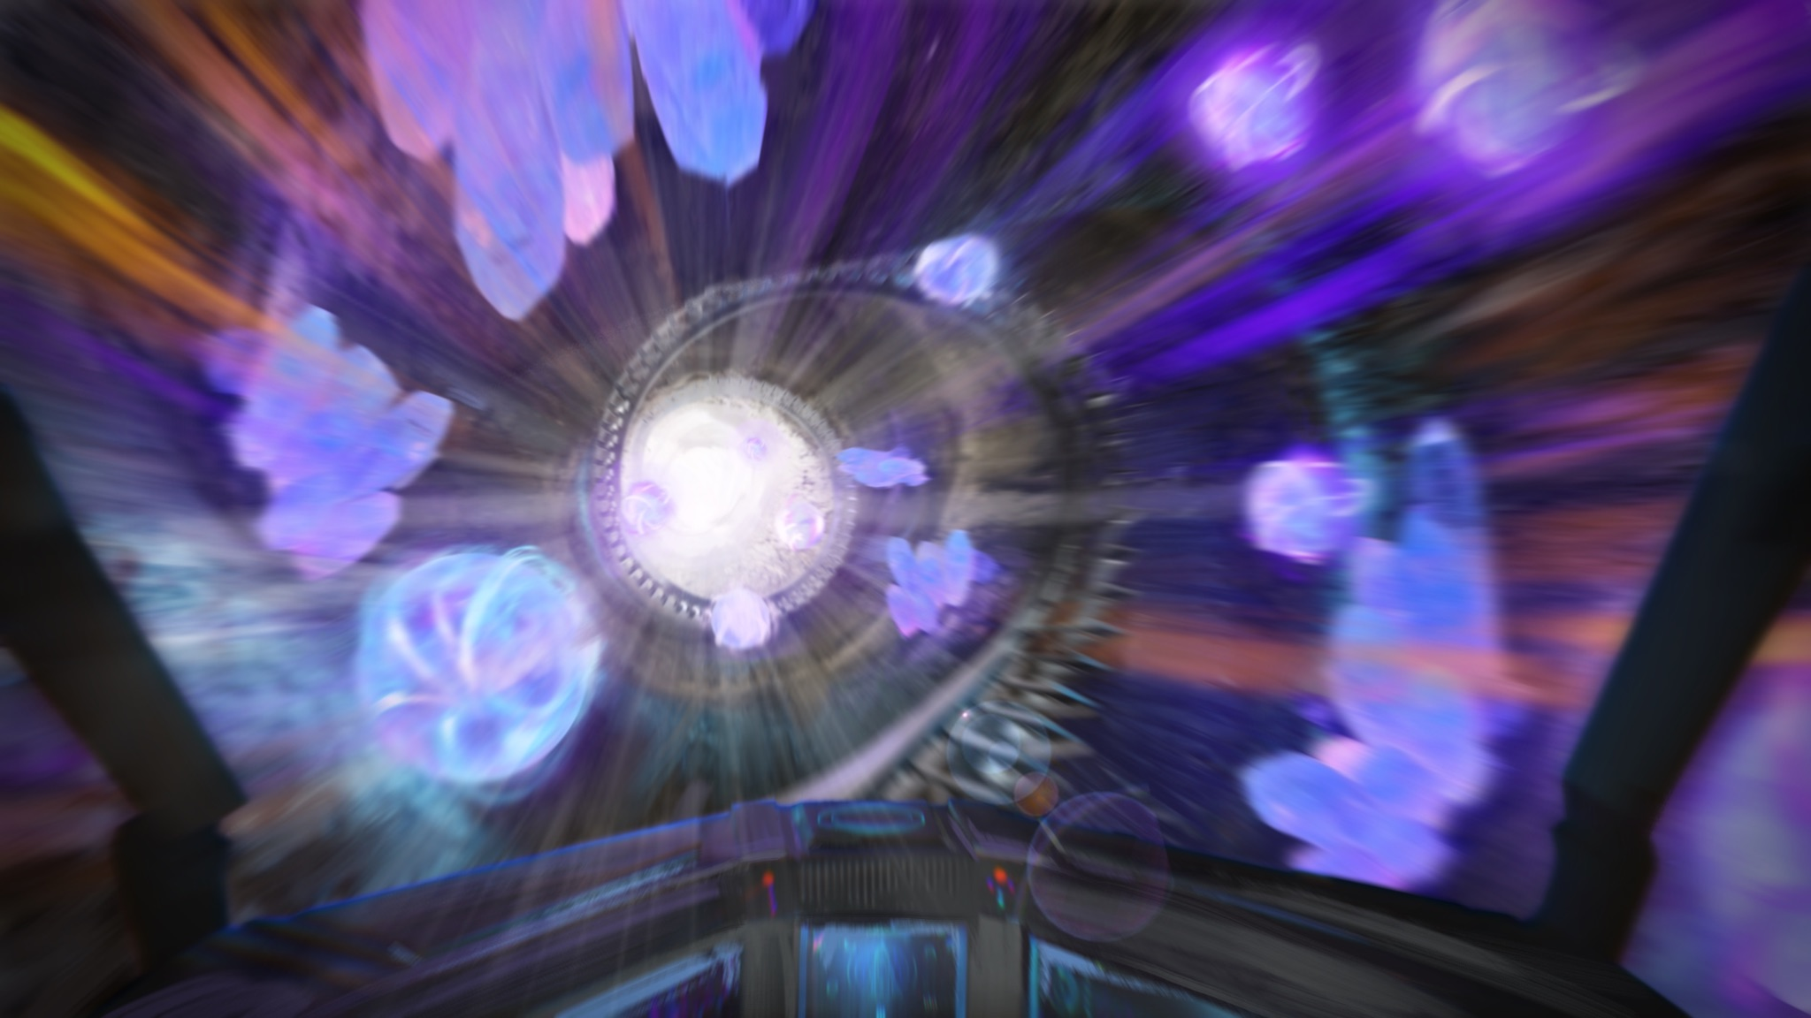
Notes:
Name: Go Deeper

Slide 11
Episode 5: Destined
The explorers exited the depths of the mountain range and entered the valley. How many days had it been since their first encounter? The spirit protecting the Orb anticipated their arrival.
Notes:
External Link
Description

Slide 12
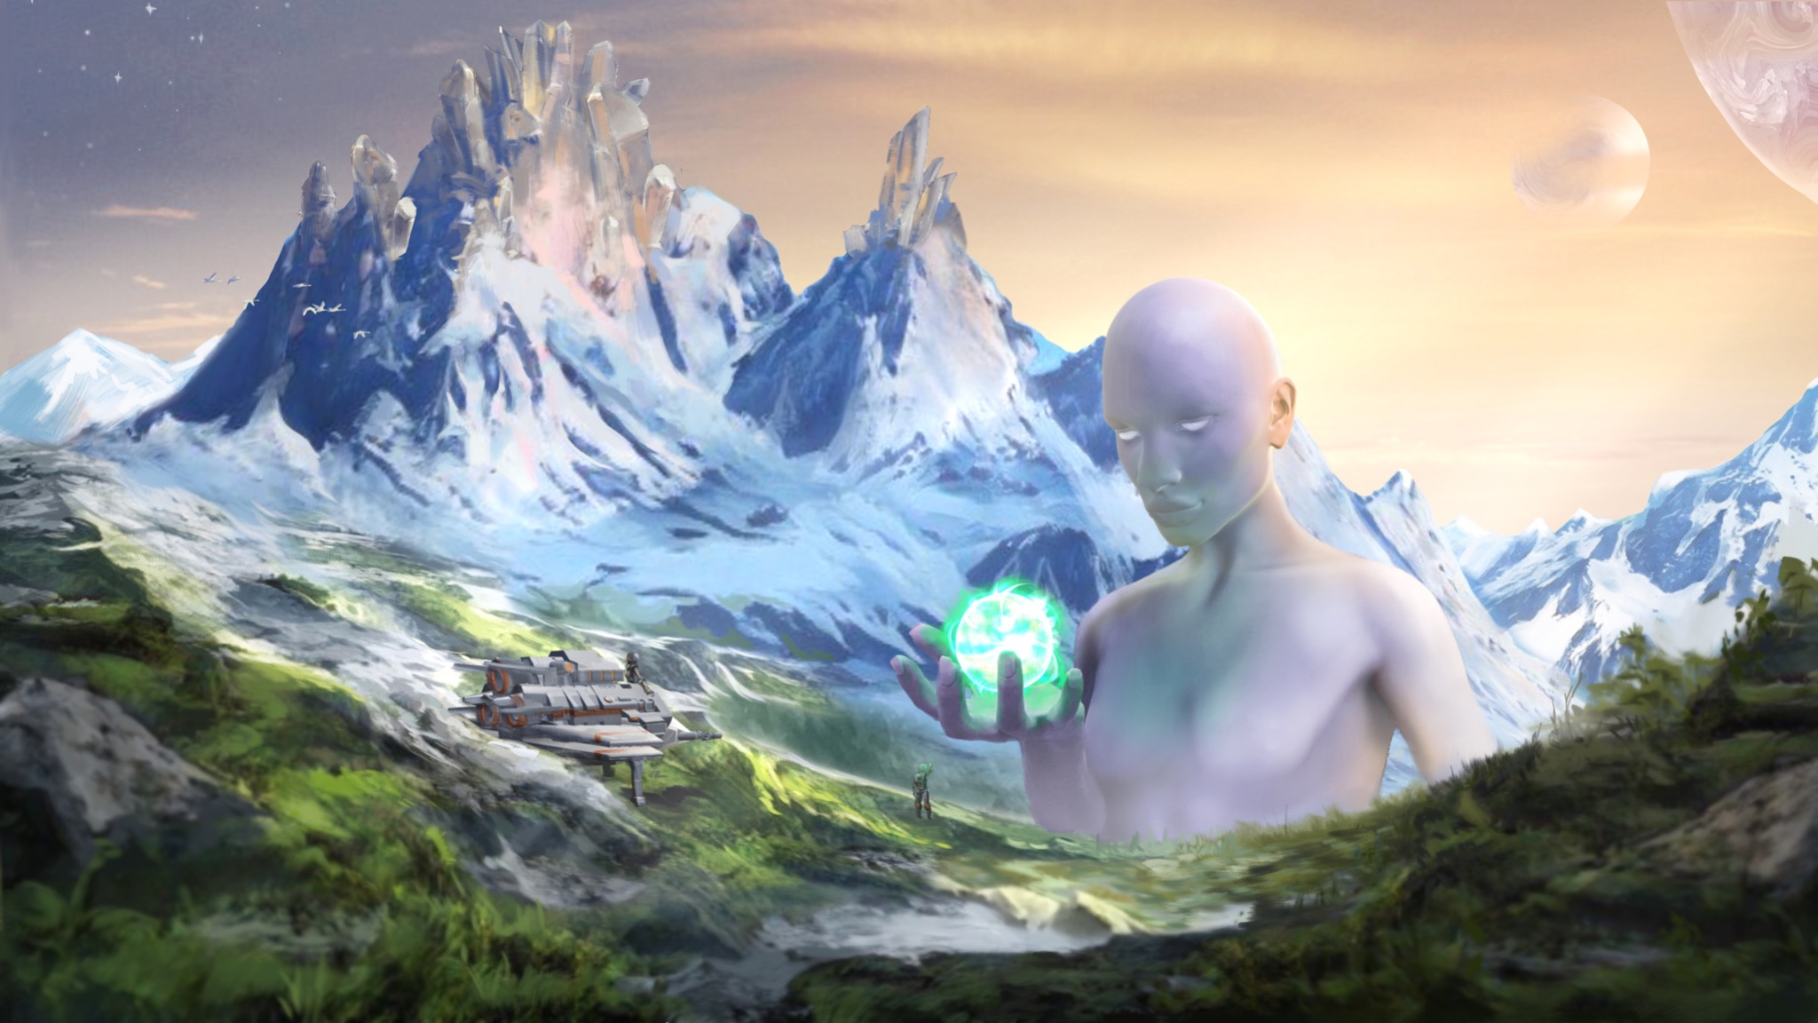
Notes:
Name: Second Encounter - The Gift
She is pleased. Grants u

Slide 13
What’s next?

Slide 14
Thank You

